Slide 1
BUS RESERVATION SYSTEM

Slide 2
TEAM MEMBERS
Amogh Deshpande
Anirudh K
Dhanashri Patil
Rupali Sharma
Sourav Patra

Slide 3
ABOUT
Online Bus Reservation is a web application which provides a user-friendly User Interface and an easy efficient way to search and book bus tickets.
User have access to search buses and apply for it. User can register on website to avail privileged facilities.
User can also change his/her registered details in the dashboard.
User can anytime login, check his/her booking details and download the ticket for previous booking.

Slide 4
PROBLEM STATEMENT
In today’s world of bus transportation many private bus transportation company have traditional approach of managing work on paper which seems to be money and time consuming.
Also not guaranteed that all transaction to be error free and may lead to many calculation mistakes in bill generation and costing.
Online bus reservation system is a project which provides an online portal for bus ticket reservation. This application allows customers to book bus tickets from anywhere and anytime.
The customer can easily book tickets at their comfort. The customer can view all the details of the seats, bus, and route along with pictures.
The customer can also view and download the details of the journey and journey timings. This will give customer an overview of the journey and will be a hassle-free task of doing bus reservation at fingertips.

Slide 5
Objectives
The objective of application is to computerize any traveling company process to manage data, so that all the transactions become faster and there should not be any error in transactions like calculation mistake, bill generation and other things.
It replaces all the paperwork. It keeps records of all the bills also, given to the customers, so that customer could update his daily accounts.

Slide 6
Technologies Used
Front End: HTML, CSS, Typescript
Back-End: Java
Database: Oracle
Frameworks: Spring Boot, Angular
Rest API for Testing: Postman

Slide 7
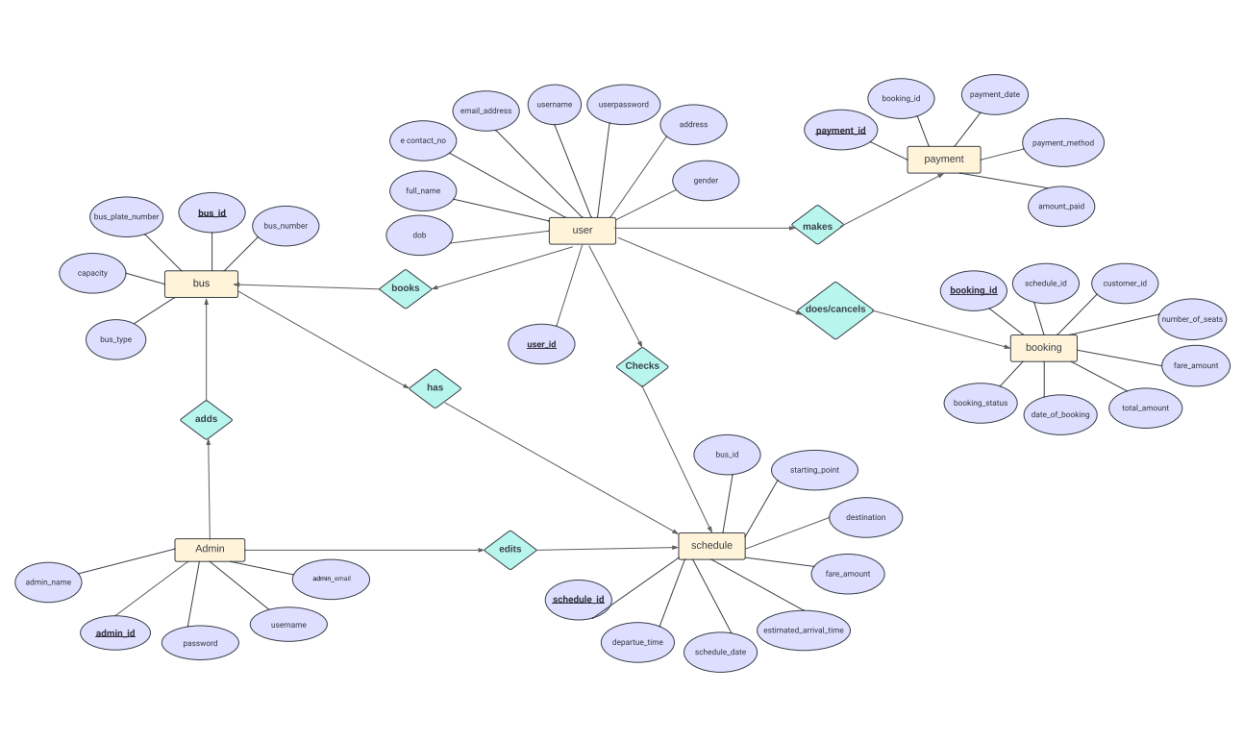
ER-DIAGRAM

Slide 8
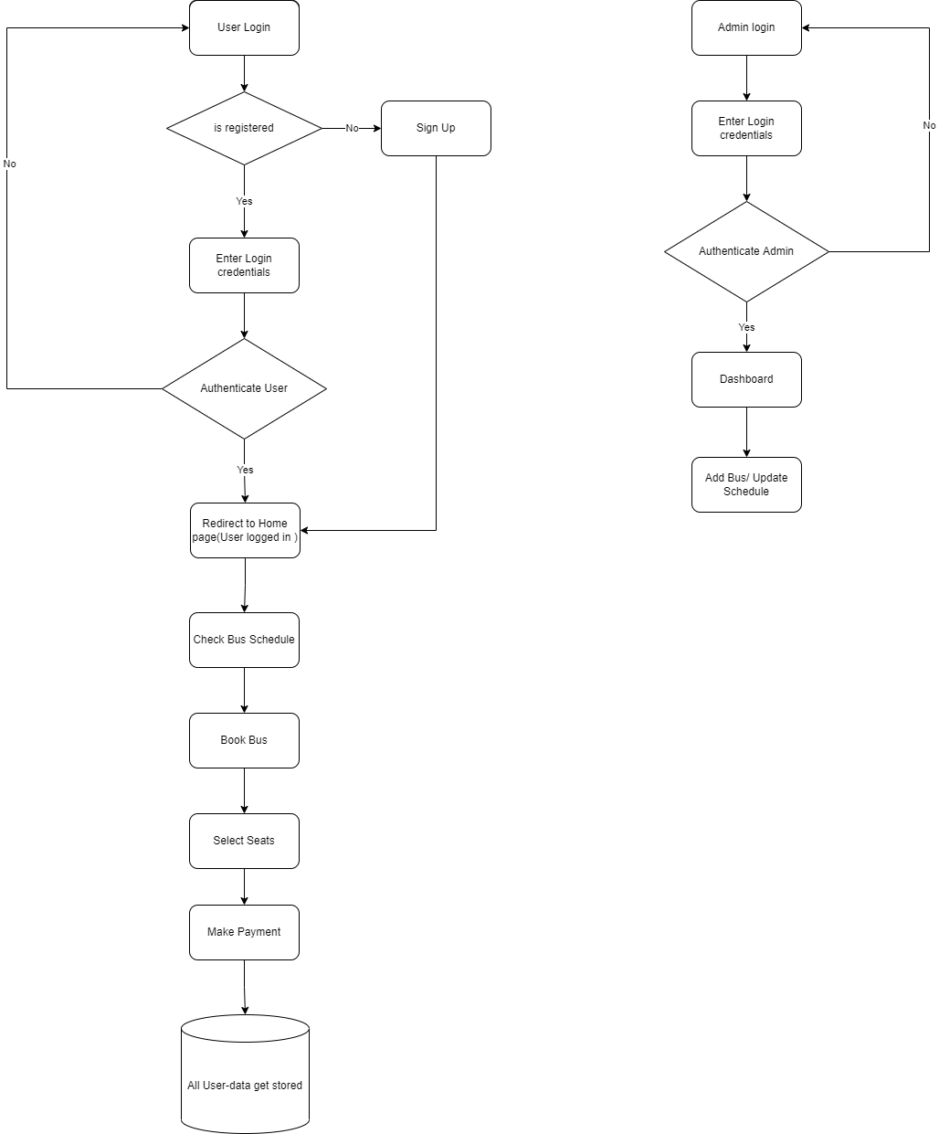
DATA - FLOW DIAGRAM

Slide 9
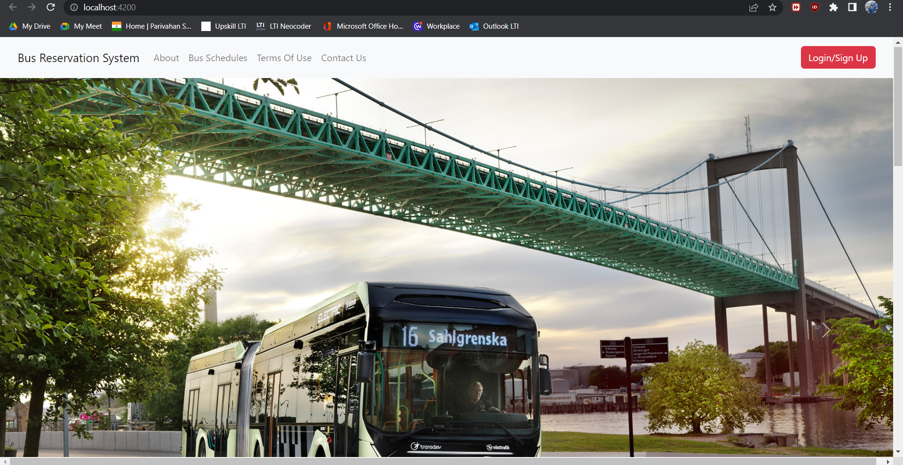
Project Glimpses: Home Page

Slide 10
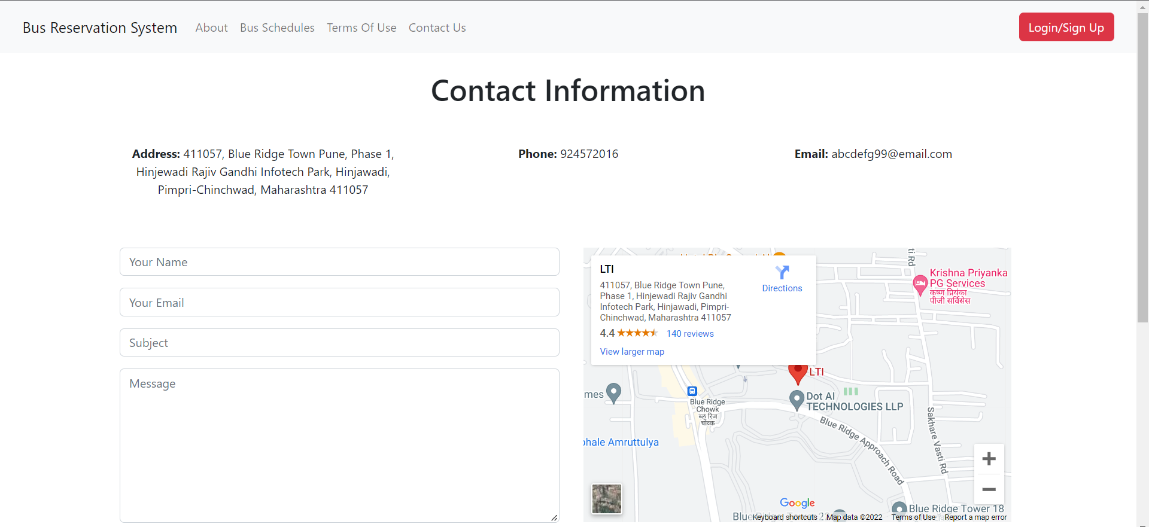
Project Glimpse: Contact Information

Slide 11
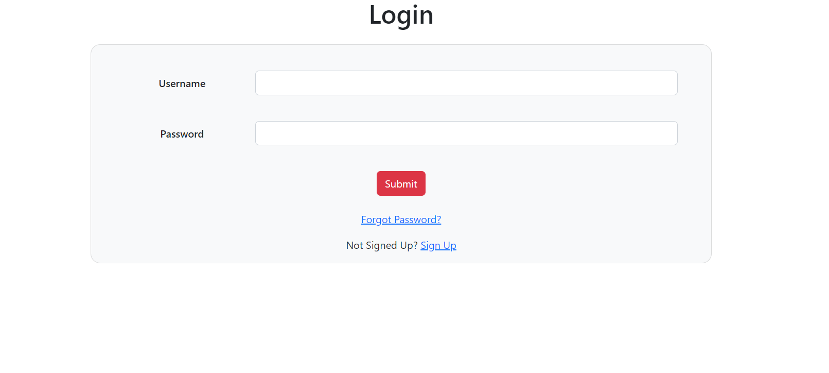
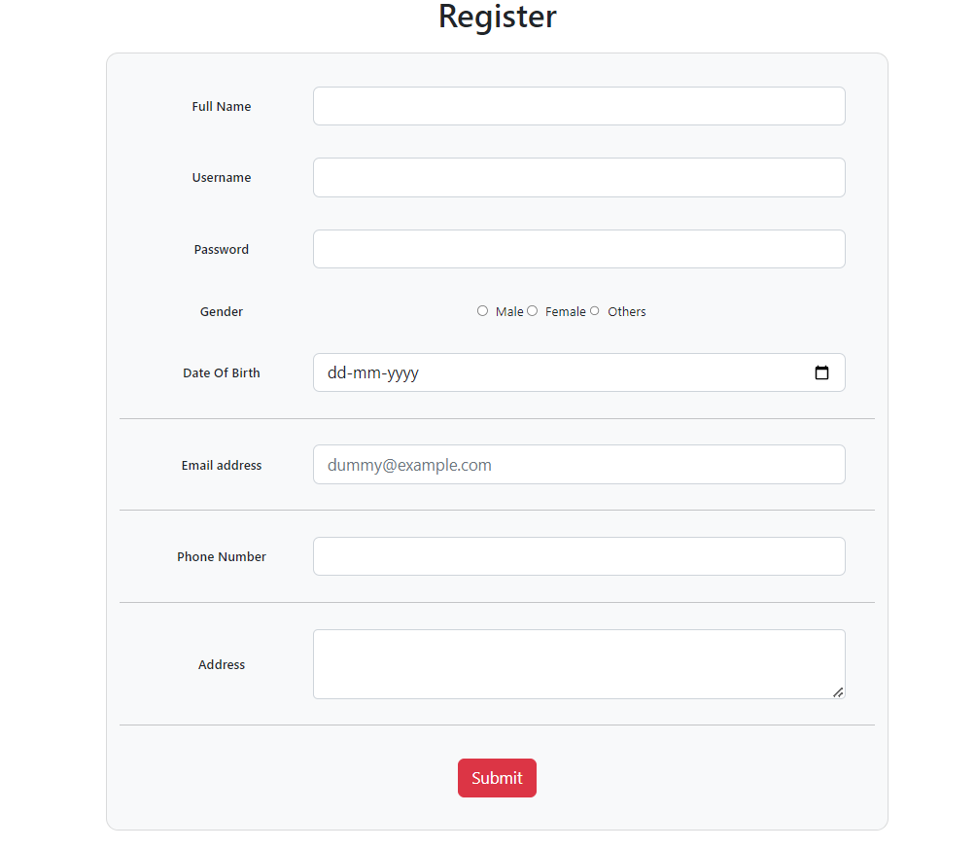
User Login/ Registration

Slide 12
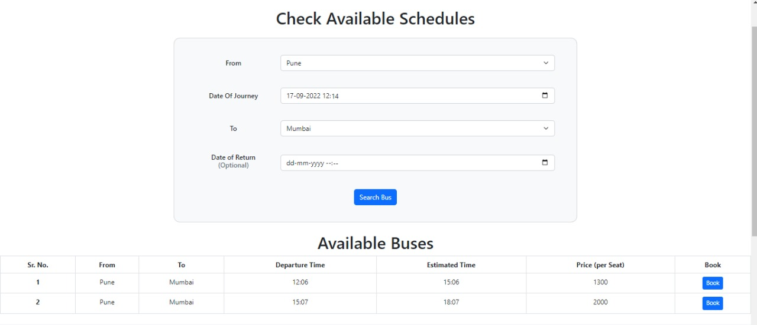
Available Schedules

Slide 13
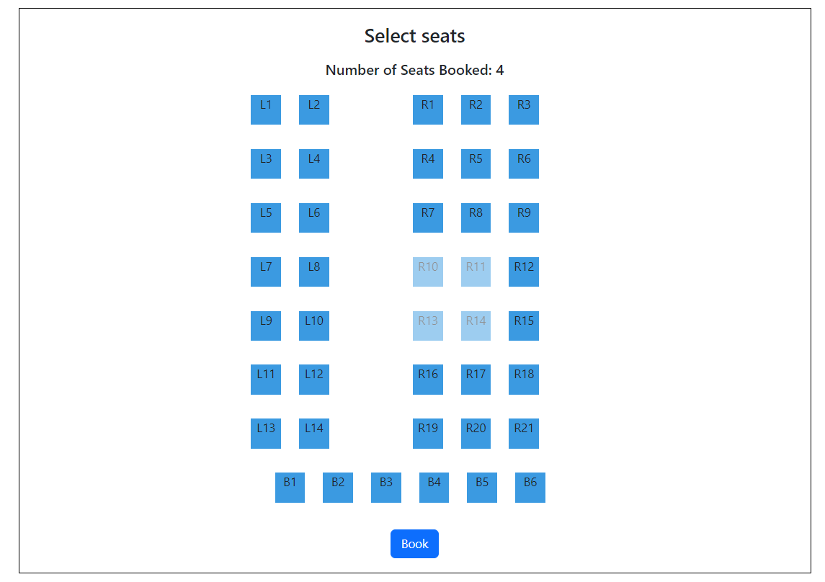
Seats Selection Page

Slide 14
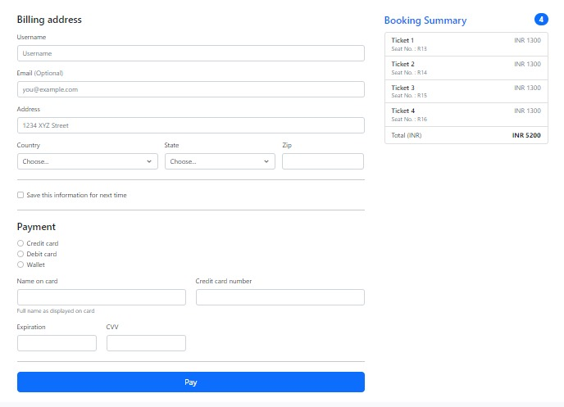
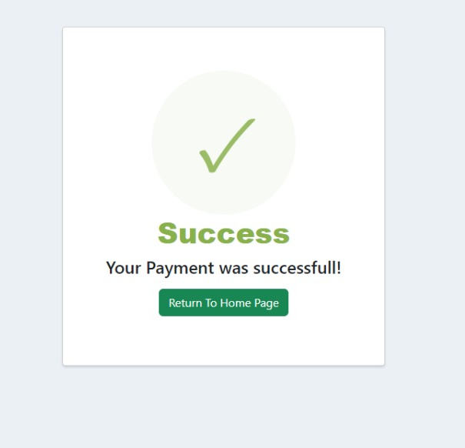
Payment Page

Slide 15
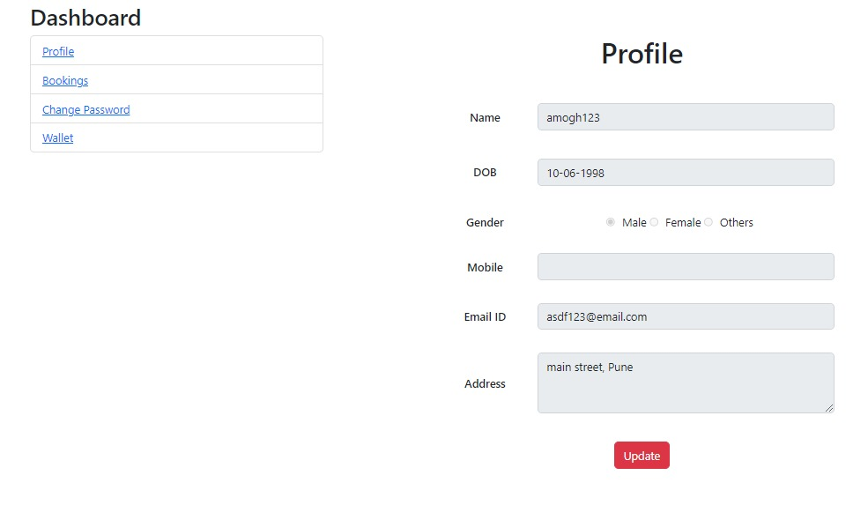
Dashboard/User’s Profile

Slide 16
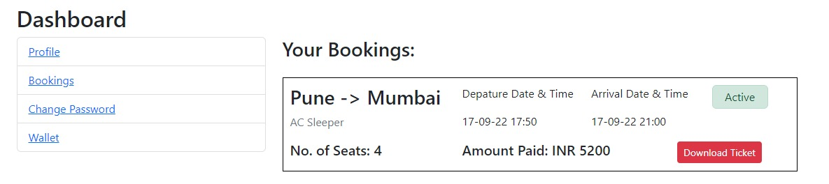
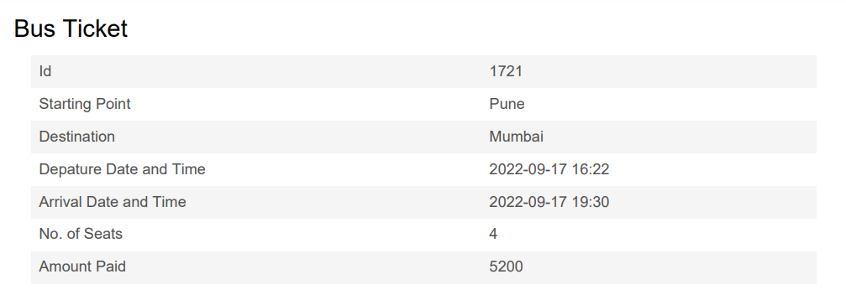
Dashboard/User’s Bookings

Slide 17
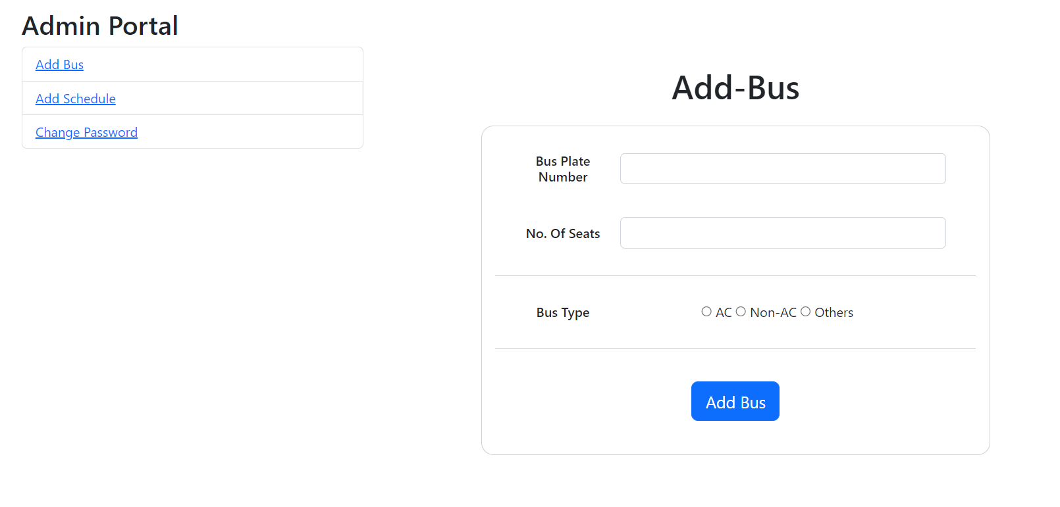
Admin: Add-Bus

Slide 18
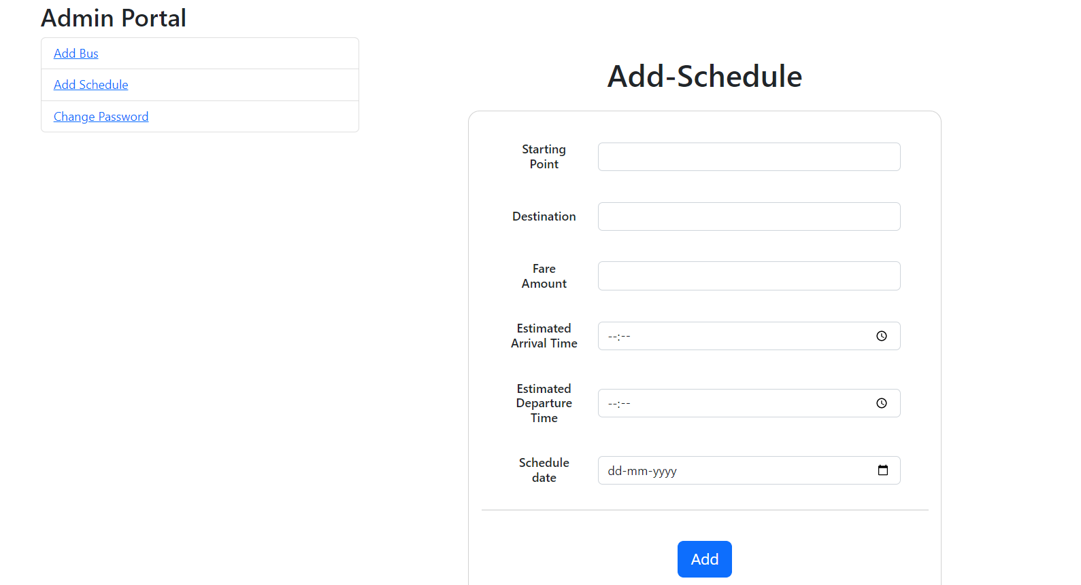
Admin Add-Schedule

Slide 19
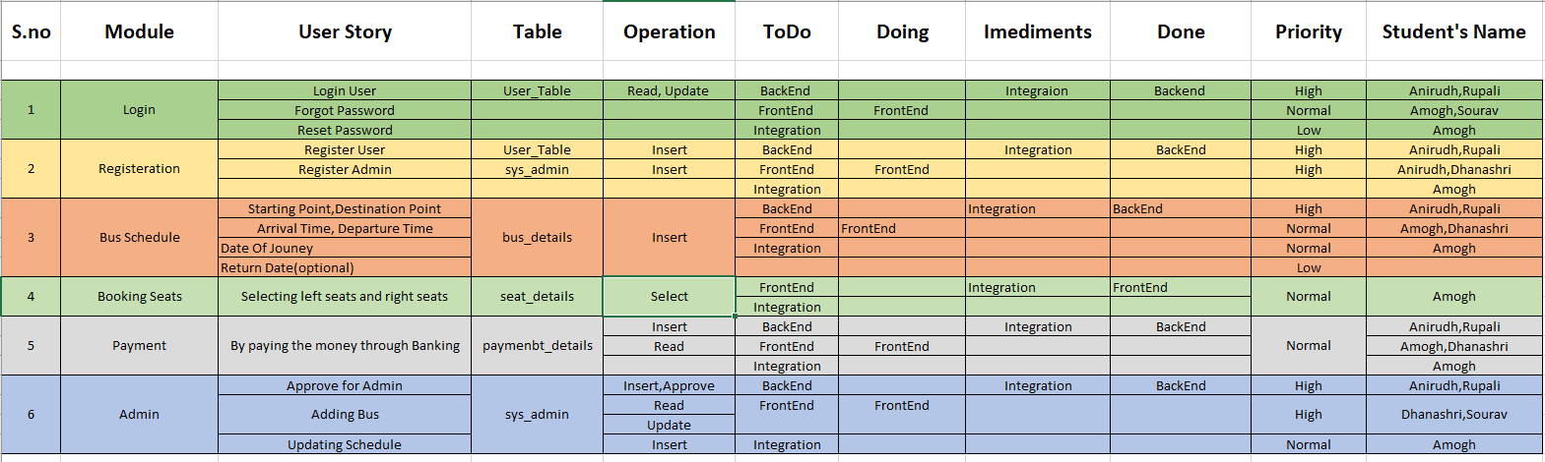
Scrum Board
Link :https://docs.google.com/spreadsheets/d/12q8EqcmpkXvoNevFBdG-NZEo9BbcQf5V/edit?usp=sharing&ouid=109844898612111137257&rtpof=true&sd=true

Slide 20
CONCLUSION
In this Project we have developed a secure, user-friendly Bus Reservation System. This Project basically provides Bus information and regarding bus information. First of all, on our website any user or visitors view our system and search the bus and how many seats are available in our buses. The user can also register their own seats on the bus on this website.

